Slide 1


PROJECT:2
Ride Rental Dataset Analysis
Company: Nexthikes IT Solution
Presented by: Deepa Pathak
DataWithDeepa https://github.com/DataWithDeepa

Slide 2


Project Overview
This project involves analyzing a ride rental dataset collected from multiple sources.
The goal is to merge datasets, clean data, perform exploratory analysis, and derive insights.
Tools used: Python, Pandas, Matplotlib, Seaborn
1
Data Cleaning
2
Merging
3
Analysis
4
Data Visualization
DataWithDeepa https://github.com/DataWithDeepa

Slide 3

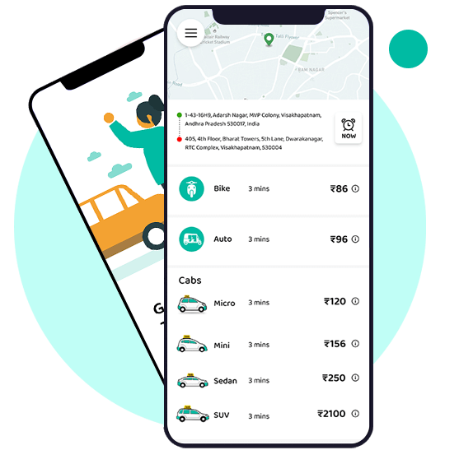
Dataset Overview
Dataset 1: Ride booking information
Dataset 2: User demographic details
Dataset 3: Ride feedback and ratings
Each dataset contains valuable insights for business decision-making.
DataWithDeepa https://github.com/DataWithDeepa

Slide 4
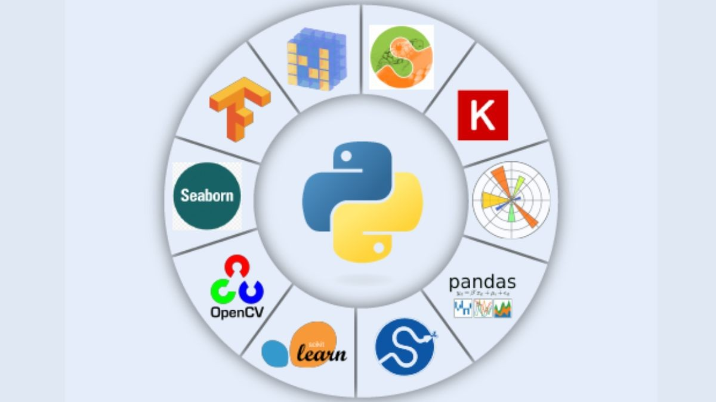
1
2
3
Libraries Used
Pandas
NumPy
Matplotlib
4
Seaborn
How?
Pandas: Data manipulation, reading CSV/XLSX, handling missing values, and merging datasets.
NumPy: Mathematical operations and efficient data handling.
Matplotlib: Creating basic charts and visualizations.
Seaborn: Advanced data visualizations (heatmaps, histograms, etc.).
DataWithDeepa https://github.com/DataWithDeepa

Slide 5

Data Acquisition & Merging
3
Read datasets using Pandas (pd.read_csv() & pd.read_excel())
Checked basic info & structure (df.info(), df.head())
Merged datasets using pd.concat()
Combines different data sources for a unified analysis.
Enables correlation between user behavior, ride details, and feedback.
Steps Taken: Why Merging ?
DataWithDeepa https://github.com/DataWithDeepa

Slide 6
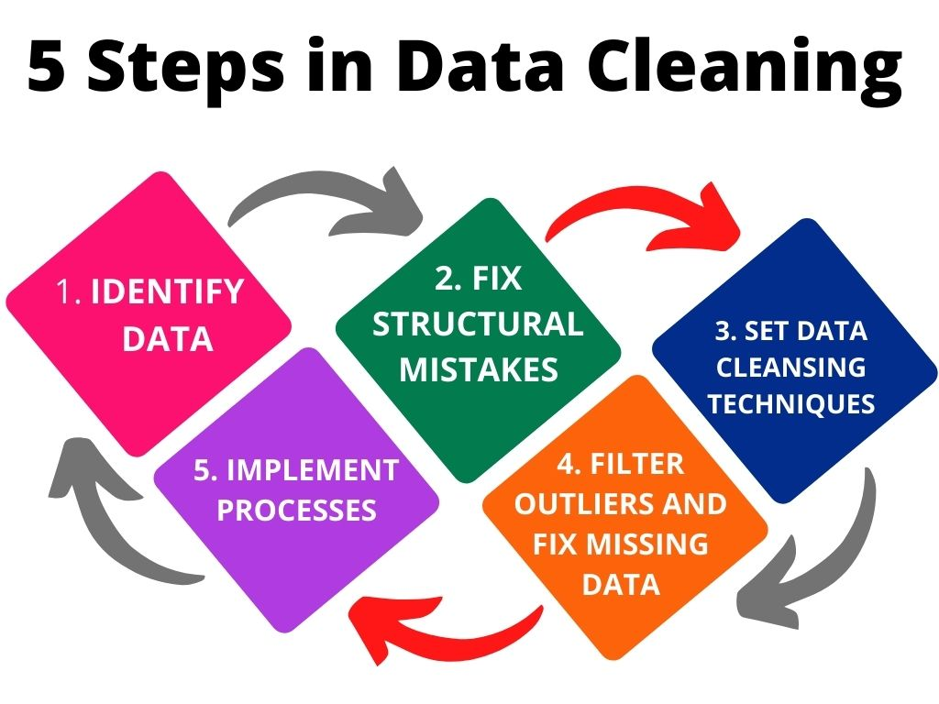
Data Cleaning Process
3
Handling Missing Values:
Forward fill (df.ffill()) to fill gaps logically.
Dropped irrelevant columns.
Handling Duplicates:
Removed duplicate rows using df.drop_duplicates().
Data Type Conversion:
Converted date columns using pd.to_datetime().
DataWithDeepa https://github.com/DataWithDeepa

Slide 7
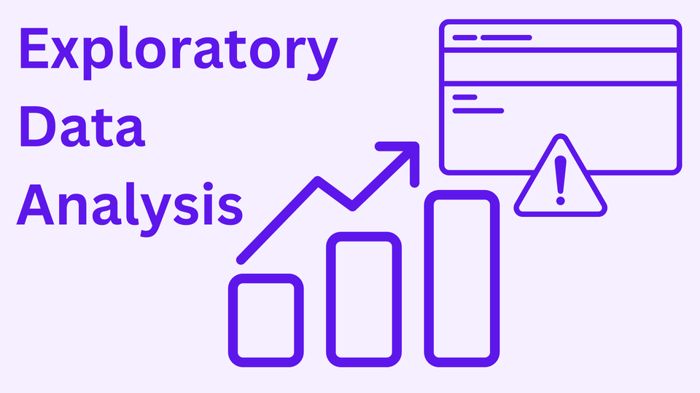
Exploratory Data Analysis (EDA)
3
Objectives of EDA:
Identify trends & patterns in ride rental data.
Detect anomalies and outliers.
EDA Steps:
Summary statistics using df.describe().
Checking missing values (df.isnull().sum()).
DataWithDeepa https://github.com/DataWithDeepa

Slide 8

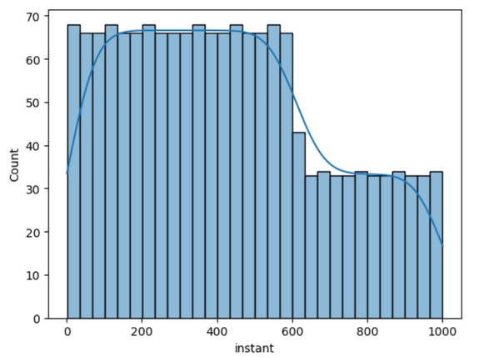

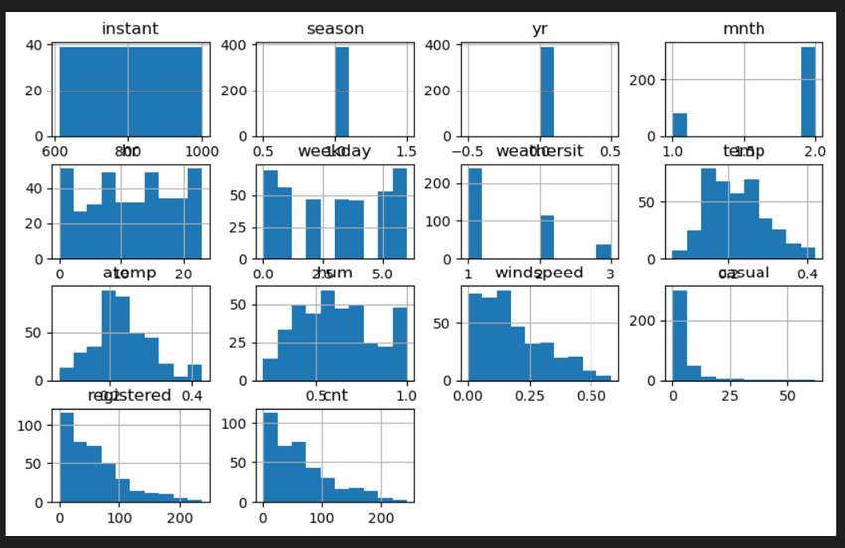
Let's Begin
Data Visualization - Ride Distribution
Histogram:
Displays the distribution of ride duration.
Helps in understanding the most common ride lengths.
Graph: Bar chart showing frequency of short vs long rides.
DataWithDeepa https://github.com/DataWithDeepa

Slide 9
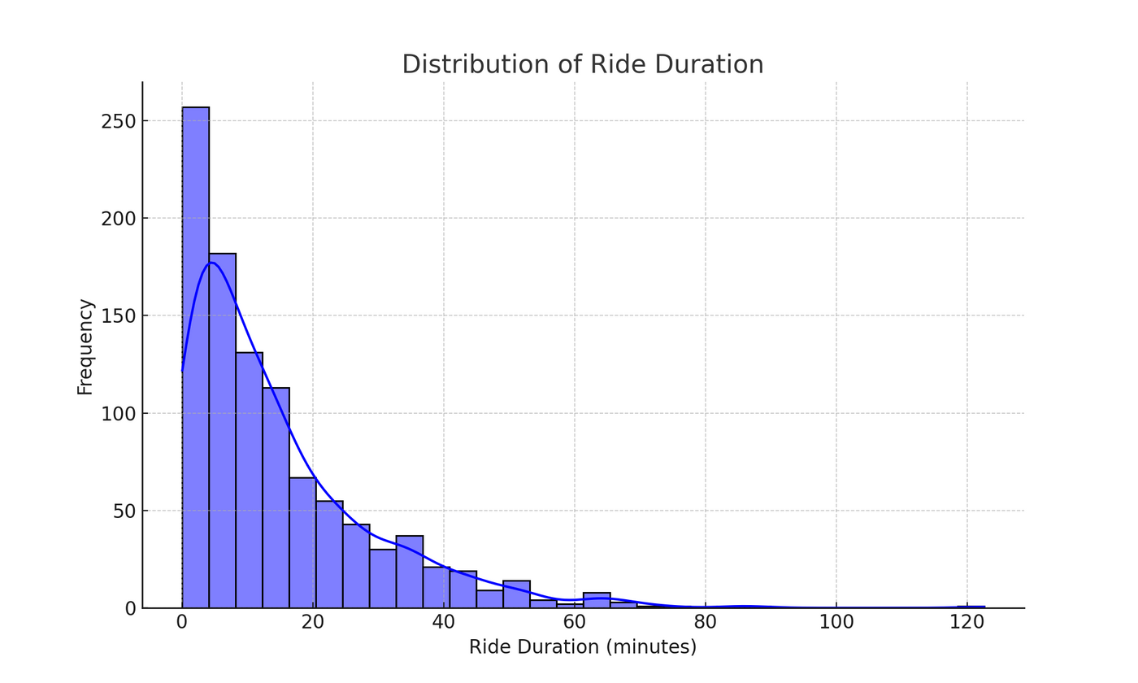
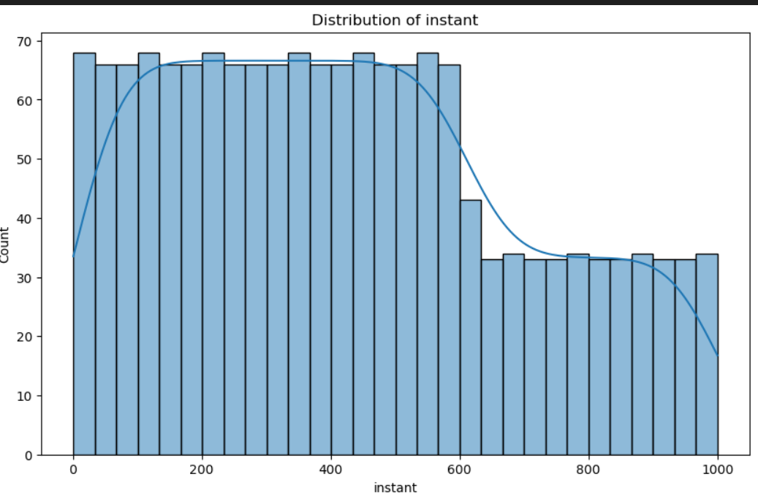
RIDE DURATION
INSTANT
DataWithDeepa https://github.com/DataWithDeepa

Slide 10
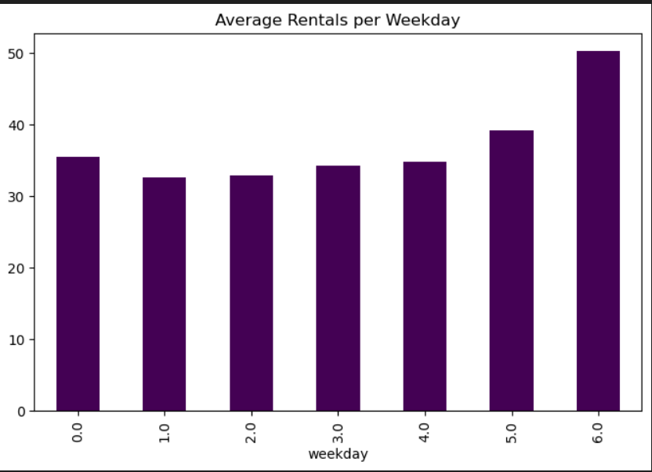
DataWithDeepa https://github.com/DataWithDeepa

Slide 11
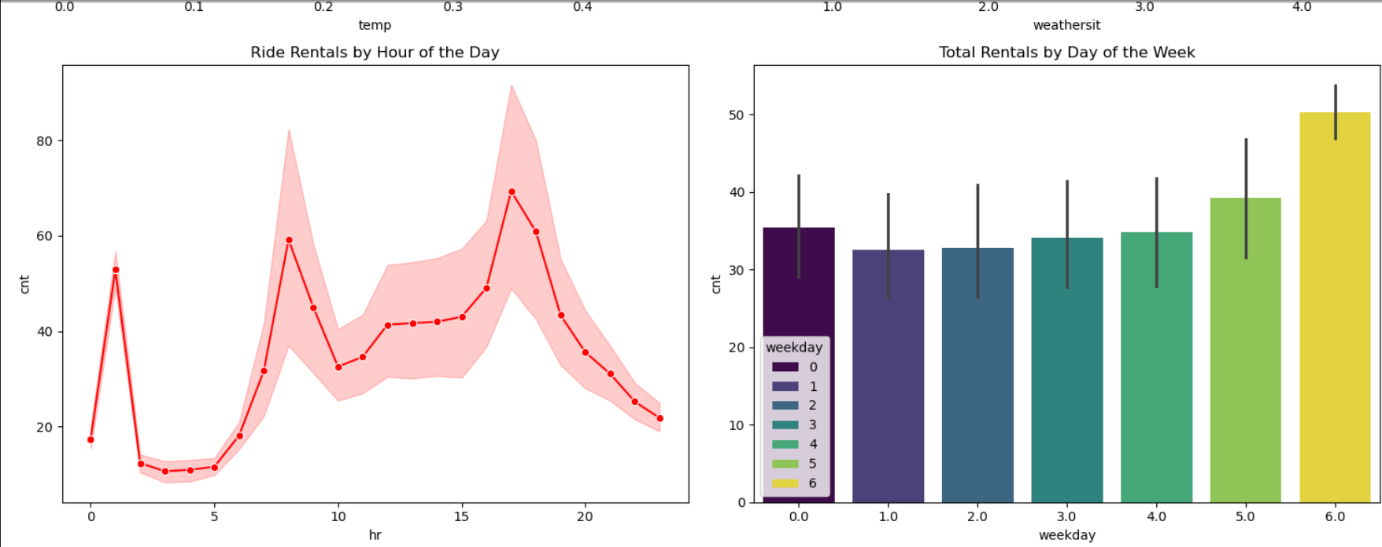
FINAL DATA VISUALIZATION
DataWithDeepa https://github.com/DataWithDeepa

Slide 12

FINAL VISUALIZATION
Temperature vs Rentals → Shows how rentals change with increasing temperature
Humidity vs Rentals → Displays the relationship between humidity and rentals
Correlation Heatmap → Highlights strong and weak relationships between dataset variables
Impact of Weather on Rentals (Box Plot)
Rentals by Hour of the Day (Line Chart)
Total Rentals by Day of the Week (Bar Chart)
DataWithDeepa https://github.com/DataWithDeepa

Slide 13

Conclusion
Understanding user behavior helps in better resource allocation
Optimized bike availability during peak hours can improve efficiency
Discount strategies can be planned based on weather conditions
Data-driven decision-making for better business outcomes
DataWithDeepa https://github.com/DataWithDeepa

Slide 14

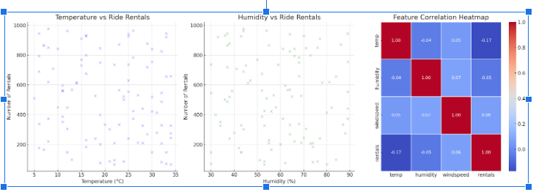
FINAL VISUALIZATION
Have a great
weekend!
DataWithDeepa https://github.com/DataWithDeepa

Slide 15
DataWithDeepa https://github.com/DataWithDeepa

